Slide 1

Sentiment Through Time: A Multi-Year Analysis of Scholarly and Public discourse on AI
Noel Mangai

Slide 2
INTRODUCTION
GOALS
Overview: Tools
The primary goal of this project is to understand any changes is sentiment regarding AI across recent history. This is achieved through:
Gathering and processing popular literature regarding AI.
Creating a timeline of major events regarding AI to notice any effects on sentiment.
Analyzing data in R to spot trends across time.
The R packages used to create this project include:
tidytext: text mining tools.
stringr: handling and manipulating strings.
glue: interpolating strings in R.
ggplot2: creating visualizations.

Slide 3
METHODOLOGY
To create an accurate and meaningful analysis:
Text data was first collected from over 60 articles across 4 years. This data was then placed into .txt files by year, respectively.
These files were then Imported into R, and subsequently preprocessed. Data cleaning involved:
Converting all letters to lowercase
Tokenizing data
Filtering common words... and more!
Next came the Analysis. Relevant words were rated either positive or negative and computed.
This was then visualized, both as word clouds and a line graph.
Lastly, Insights, key takeaways for future planning were made.

Slide 4
DATA COLLECTION
So, How was data acquired?
Data was collected from multiple sources.
Research and opinion articles pulled through google scholar.
Sorted for the most relevant in each given year.
Keyword in search: AI
Only articles containing opinionated wording selected, regardless of sentiment.
60 articles were chosen in total.

Slide 5
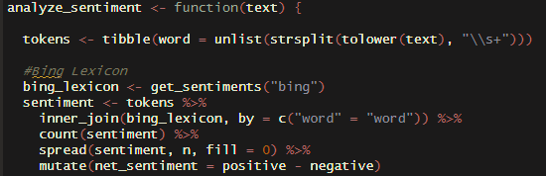
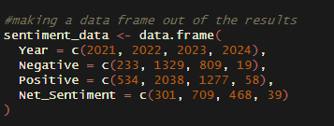
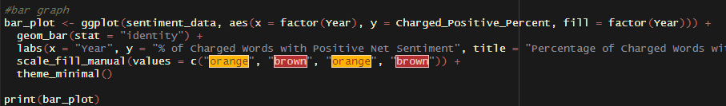
DATA
After the preprocessing and tokenization of data, sentiment analysis was performed using the Bing Lexicon. From this, we get Net Sentiment.
This process was then Looped for each file, and then a data frame containing all results was made
The data was then visualized into a plot using the ggplot2 package. Further visualization was also performed.

Slide 6
AI THROUGH THE YEARS
2023
Sam Altman leaves, then returns to open AI.
Rise of rudimentary Text-to video Tools.
2021
Dall-E 1 is Released.
AI used in vaccine development.
2024
Sora announced by OpenAI.
Nvidia becomes the 3rd most valuable publicly traded company.
2022
ChatGPT 3.0 is
Released.
DeepMind creates AlphaCode.

Slide 7
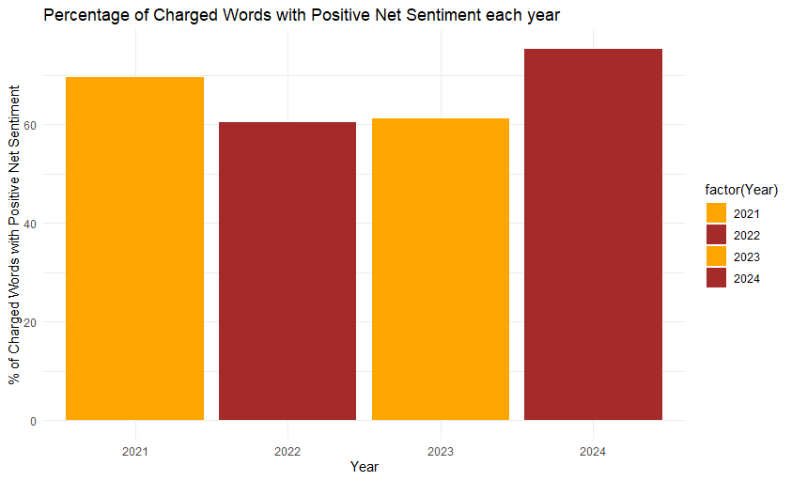
ANALYSIS
The data does not contain any dramatic increases or decreases by year.
Overall, sentiment has gone up.
Dip in sentiment in 2022. The same year ChatGPT was released.
Overall, AI is viewed positively.

Slide 8
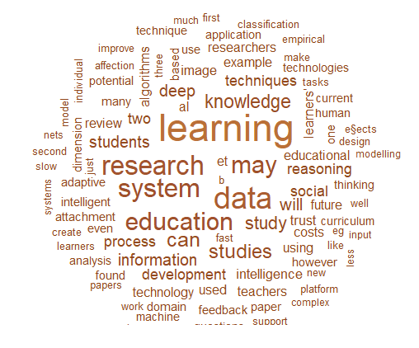
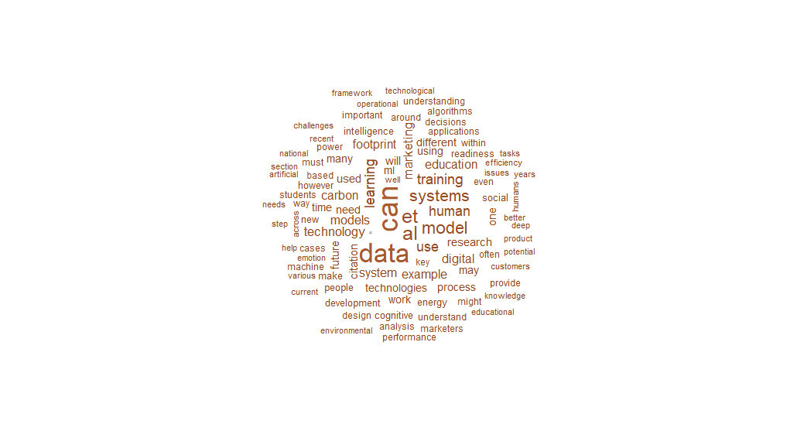
ANALYSIS CONTINUED: INSIGHTS
The dip in sentiment in 2022 coincides with the release of ChatGPT. This may be due to early skepticism of the technology
The overall positive sentiment may be due to the subsequent Integration of AI in daily life, and the acknowledgement of its benefits.
2021 , 2022 Word Clouds respectively

Slide 9
LIMITATIONS
Limited Scope and Sample Size: The dataset consists of 60 articles collected from Google Scholar. This may not fully capture opinion diversity across demographics and regions,
Publication Bias: This analysis primarily focuses on articles from peer-reviewed sources, creating a bias in and of itself.
One-Dimensional Analysis: This analysis focuses only on sentiment but does not consider other factors such as the underlying reasons for sentiment, a multidimensional analysis would offer a much more comprehensive understanding of opinion on AI.
Subjectivity: Sentiment is fluid. It cannot be stated that the Bing lexicon, while sufficient, is 100% accurate in capturing the nuances of human language.

Slide 10
CONCLUSION
Through comprehensive and thoughtful analysis of trends in articles, this study offers valuable insight into perceptions of artificial intelligence. Despite the limitations outlined earlier, several key findings are brought forth:
Overall Positive Sentiment
Fluctuations coinciding with the release of ChatGPT
Diverse Perspectives
Limitations and Future Directions
This project, completed in R, represents just a small snapshot of the landscape that is humanity’s growing relationship with AI technology. Continued research and ongoing dialogue are essential in acquiring a deeper understanding of the societal impact of AI and ensuring this tool is used for the betterment of our lives.

Slide 11

THANK YOU.

